Slide 1
Virtualization and Storage
‘Do More with Less’
November 2008

Slide 2
Virtualization is Strategic
2
Virtualization ranks as the No. 1 strategic technology for next year,
not for its ability to virtualize servers, but for its increasing capability to virtualize just about everything else in a data center...
in storage, for instance, virtualization allows users to "to combine different kinds and generations of storage technology.“
Notes:
SANsymphony Product Introduction
Copyright 2000 DataCore Software Corporation
2

Slide 3
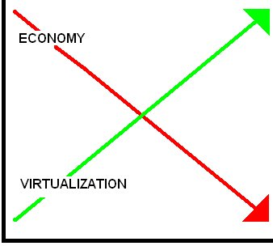

Storage Virtualization & the Economy
3
"It's a lot easier for customers to put off the purchases of servers, some software and applications, and even desktops than it is to put off storage purchases. Once a company moves into the digital world ... information just piles up. You've got to have some place to put it."
“Software - do more with less”
“Storage Virtualization let’s you get the most from your existing investments.”
“Storage Virtualization software appeals
to buyers with limited budgets.”
“Users are concentrating on projects that bring payback within 12 months or less. Obvious areas to look at are servers and storage
that haven't been virtualized and consolidated.”
Notes:
SANsymphony Product Introduction
Copyright 2000 DataCore Software Corporation
3

Slide 4
Storage Virtualization & the Economy
4
Storage Innovators Series
Enterprise Systems Journal
Nov 4, 2008
“ DataCore Software...I see their software today
as offering even greater value in the context
of the recessionary economy.”
- Jon Toigo
Notes:
SANsymphony Product Introduction
Copyright 2000 DataCore Software Corporation
4

Slide 5
DataCore = Savings and Productivity
5
Consolidate & Optimize Your Storage by 60%
  Get full use of what you own, purchase storage on ‘as needed basis’
  Save on floor space, capacity costs and energy
Lower Initial and On-going Costs by 50% plus and Future Proof Your Storage Investments
  Value protection upgradability – pay as needed
  Future proofing - enduring Software, lives beyond the hardware
Slash Business Downtime Costs (From Weeks to minutes or zero)
  Cost-effective solutions make HA and DR practical
  More Productivity - ‘True High-Availability” Business Protection
Enhance Performance (2-4X) & Improve Admin Productivity (3-10X)
  Automation, SAN-wide Centralized Management, Thin Provisioning
  Do more in the same timeframe – Accelerate Performance 2-4X!
Notes:
SANsymphony Product Introduction
Copyright 2000 DataCore Software Corporation
5

Slide 6
DataCore: Value, Cost Savings and R.O.I.
2X Performance
Plus serve more users
with existing resources
Eliminate
downtime attributed
To storage
10X More
managed capacity
per administrator
Double
disk utilization
40% 80%+
4
3
2
1
Unmatched Performance
Open Connectivity
Ethernet iSCSI
Fibre Channel
Either or BOTH
Auto Failover/Failback
Business Continuance
Disk-to-Disk Backups
Disaster Recovery
Centralized
Management
Automation
Thin Provisioning
Consolidation
Optimal Resource
Utilization
Network Pooling

Slide 7
Savings & ROI from DataCore Virtual SANs
Savings: DataCore Storage Area Network (SAN)
Traditional Direct Attached Storage (DAS)
Greater Capacity Utilization:
      DAS = 25%-40% (i.e., 60% to 75% of storage assets are wasted)
      SAN = 85%-90% DataCore = Fullest Use!
Lower Administrative & Environmental Costs:
      Ratio of DAS to SAN costs = 3 to 10X Better Productivity (i.e., 3 to 10 times as much admin to manage the same amount)
      Note Avg. Burdened Salary ($75,000 - $95,000)
      Pooling of cost-effective storage = Buyers Choice
      Serve storage from Arrays, disks, Server/blade storage…
More Uptime – SANs dramatically increase availablity:
      Average revenue lost per employee-hour is $275.00
      100 employee impact = $27,500 per hour
      DAS = 98.0% uptime (60 hours/yr downtime)
      SAN = 99.9%+ uptime (1hour/yr downtime or less)
Notes:
Multiple reports and studies show the potential savings. Numerous customers have realized these savings.

Slide 8
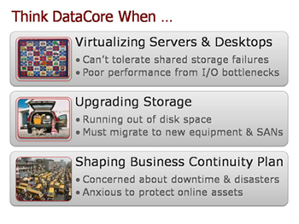
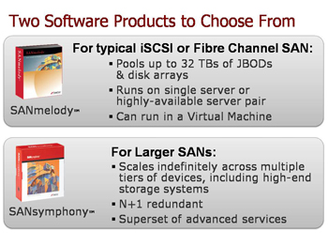
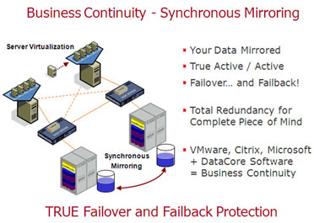
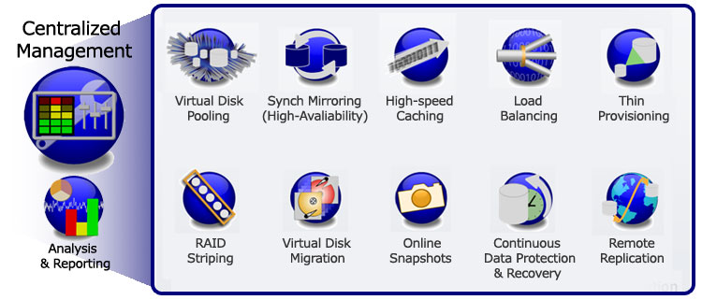
DataCore Solutions
8
Notes:
SANsymphony Product Introduction
Copyright 2000 DataCore Software Corporation
8

Slide 9
Virtualization & SAN
9
Storage growth never stops…
High-Availability SAN are critical to protect against “all the eggs in one basket” impact of virtual server consolidation…
Virtualization magnifies I/O load…
High Cost of traditional SAN limit and delay Virtual Server deployments…
Notes:
SANsymphony Product Introduction
Copyright 2000 DataCore Software Corporation
9

Slide 10

Business Continuity
DataCore does high-availability better…
Sweet Spot – ‘High-Availability SAN for SMB’
“DataCore does high-availability better… making business continuity and disaster recovery solutions practical"
  Simple Fail-safe SAN data protection
  Unique Automatic Failover and Failback
  Priced right for Small and Mid-size Business
    Full-featured HA SAN software from $10,000
  No-penalty upgradability and “future proofed” growth path

Slide 11






Before Server Virtualization: Physical Isolation
~15 Users
~30 Users
~20 Users
~35 Users
Few people depend on each physical resource
Hardware changes more confined
~30 Users
Notes:
Before server virtualization, the consequences of storage-related interruptions were much more isolated when each server had its own separate slice of disks. You could better coordinate planned downtime since a smaller set of users was impacted. Some could even continue to operate offline from their PCs or workstations pretty much unaffected.
SANsymphony Product Introduction
Copyright 2000 DataCore Software Corporation
11

Slide 12


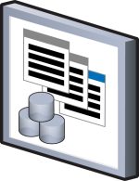

After: Concentrated Workloads
5X More
Users
Physical Server
Virtual
Machines
Notes:
Now consider that when you have multiple virtual machines or virtual desktops sharing the same disk subsystems, far more users will be affected when you take down the physical server to reconfigure, replace or upgrade components of your disk arrays. And far more users will complain when disk bottlenecks arise from the aggravated work loads; not to mention when a disk crashes or a disk array gets damaged accidentally or by forces of nature.
Can you appreciate how having DataCore’s storage virtualization software insulates your virtual server environments from the adds, moves and changes in the physical disk configuration? And how using it to boost the performance of the disk subsystems quickly becomes the priority?
SANsymphony Product Introduction
Copyright 2000 DataCore Software Corporation
12

Slide 13
Result: Pronounced Dependency on Storage
5X More
Workload
Magnifies impact of:
I/O Bottlenecks
Interruptions
Physical Server
Shared Resources
Virtual
Machines
Notes:
Now consider that when you have multiple virtual machines or virtual desktops sharing the same disk subsystems, far more users will be affected when you take down the physical server to reconfigure, replace or upgrade components of your disk arrays. And far more users will complain when disk bottlenecks arise from the aggravated work loads; not to mention when a disk crashes or a disk array gets damaged accidentally or by forces of nature.
Can you appreciate how having DataCore’s storage virtualization software insulates your virtual server environments from the adds, moves and changes in the physical disk configuration? And how using it to boost the performance of the disk subsystems quickly becomes the priority?
SANsymphony Product Introduction
Copyright 2000 DataCore Software Corporation
13

Slide 14
Overcome I/O bottlenecks & Business Disruptions
14
DataCore accelerates Storage I/O…
  Cost Effective & Fast Caching and Load Balancing
  DataCore does high-availability better…
  Simple Fail-safe SAN data protection
  Insulate Failures Transparent to Applications
  Unique Automatic Failover and Failback
  Priced right for Small and Mid-size Business
    Full-featured HA SAN software from <$10,000
  No-penalty upgradability and “future proofed” growth path
Notes:
SANsymphony Product Introduction
Copyright 2000 DataCore Software Corporation
14

Slide 15
High-Availability & Disaster Recovery
Disaster
Recovery
Site
Main Computer Site
Virtual
Server Pool
Virtual
SAN
Auto
Replicate
Remotely
Internet
Auto
Failover
Known-good copy
Virtual
Disk Pool
Notes:
What may have seemed an impossibly distant goal of an ideal, robust, multi-site IT DR environment, can suddenly be realized quickly and inexpensively. Just how quickly is your call.
We’re here to help you phase in the changes to suit your pace.
SANsymphony Product Introduction
Copyright 2000 DataCore Software Corporation
15

Slide 16
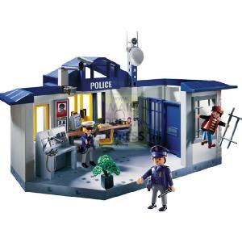
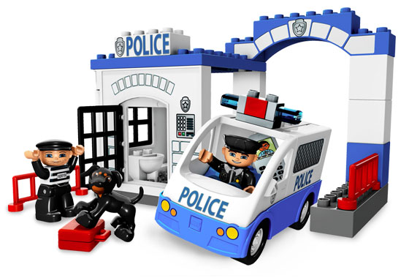
Case In Point
Customer Challenge:
$200,000 budgeted for virtual infrastructure. Surprised to learn that SAN alone
cost over $190K
Solution:
Business Continuity
within budget using DataCore
300 Users
SQL Server, Exchange
40 App Servers
Windows VMs
10TB
Police Station
10 Miles
Co-location
Notes:
16
A live customer example will help you see the economic appeal of DataCore’s software.
In this case study, we feature the Town of South Windsor in Connecticut. [ Substitute you preferred case study to make the point ]
Their police department had budgeted $200,000 to move from physical application servers to a virtual server infrastructure. To their amazement, quotes for the SAN alone using conventional techniques on purpose-built disk subsystems chewed up $190,000. Clearly this was unworkable.
DataCore enabled the customer to install the required SAN (using 2 SANmelody Servers) and implement automatic failover from the production location to a co-location facility 10 miles away for a fraction of the cost. Their environment encompasses 300 SQL Server and Exchange users spread across 40 application servers running Windows on VMware ESX. They started at 10TBs and have since expanded their environment to include a distant 3rd node to which they replicate critical volumes over the Internet.

Slide 17
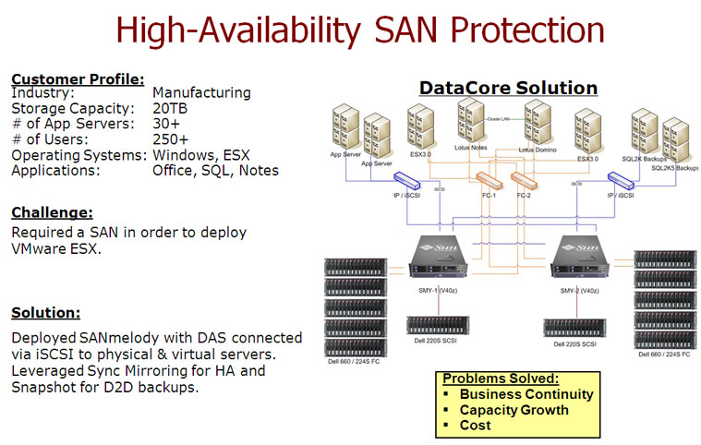
17
Notes:
SANsymphony Product Introduction
Copyright 2000 DataCore Software Corporation
17

Slide 18
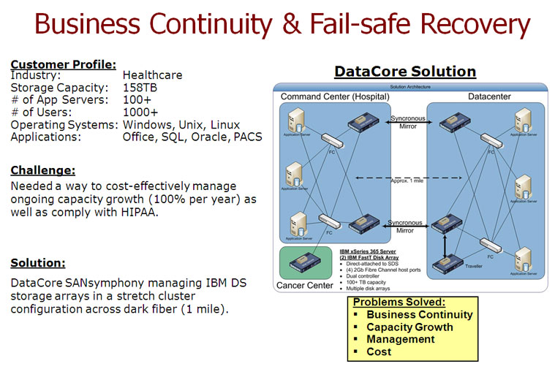
18
Notes:
SANsymphony Product Introduction
Copyright 2000 DataCore Software Corporation
18

Slide 19
DataCore = Savings and Productivity
19
Consolidate & Optimize Your Storage by 60%
  Get full use of what you own, purchase storage on ‘as needed basis’
  Save on floor space, capacity costs and energy
Lower Initial and On-going Costs by 50% plus and Future Proof Your Storage Investments
  Value protection upgradability – pay as needed
  Future proofing - enduring Software, lives beyond the hardware
Slash Business Downtime Costs (From Weeks to minutes or zero)
  Cost-effective solutions make HA and DR practical
  More Productivity - ‘True High-Availability” Business Protection
Enhance Performance (2-4X) & Improve Admin Productivity (3-10X)
  Automation, SAN-wide Centralized Management, Thin Provisioning
  Do more in the same timeframe – Accelerate Performance 2-4X!
Notes:
SANsymphony Product Introduction
Copyright 2000 DataCore Software Corporation
19

Slide 20

Get the Most From Your Storage
Fullest Utilization
Highest Availability
Fastest Performance
Yet, More Economical to
Acquire, Manage, Protect & Maintain
Notes:
And you’ll be happy knowing that through DataCore’s software you’ll get the fullest use, the highest availability and fastest performance from your storage investments. You’ll also find it more economical to buy, provision, manage, protect and maintain your physical and virtual IT environment today and in the foreseeable future.

Slide 21
Thank You …
www.datacore.com

